Slide 1

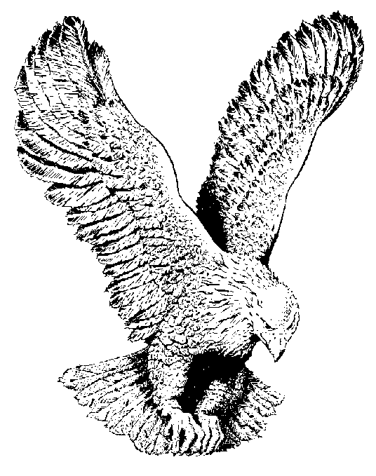
739 COMING DOWN, DOWN, DOWN
It’s coming down, down, down
It's coming down (Amen)
And the Spirit (glory) of the Lord is coming down
When the saints begin to pray
For the Lord to have His way
And the Spirit (glory) of the Lord is coming down.

